Slide 1
TURING MACHINES AND COMPLEXITY

Slide 2
Introduction
A Turing Machine is an accepting device which accepts the languages (recursively enumerable set) generated by type 0 grammars.
It was invented in 1936 by Alan Turing.

Slide 3
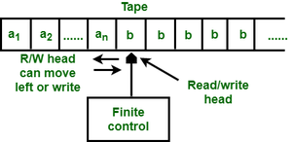
Design of Turing Machine
A Turing Machine (TM) is a mathematical model which consists of an infinite length tape divided into cells on which input is given.
It consists of a head which reads the input tape. A state register stores the state of the Turing machine.
After reading an input symbol, it is replaced with another symbol, its internal state is changed, and it moves from one cell to the right or left.
If the TM reaches the final state, the input string is accepted, otherwise rejected.

Slide 4
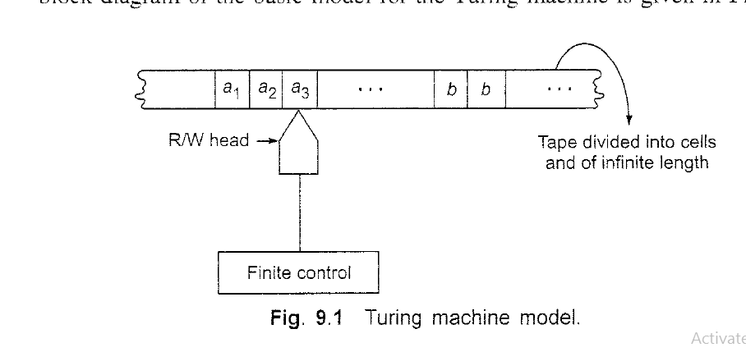

Slide 5
Introduction
Generalize the class of CFLs:
Non-Recursively Enumerable Languages
Recursively Enumerable Languages
Recursive Languages
Context-Free Languages
Regular Languages

Slide 6
Definition
A TM can be formally described as a 7-tuple (Q, X, ∑, δ, q₀, B, F) where −
Q is a finite set of states
X is the tape alphabet
∑ is the input alphabet
δ is a transition function; δ : Q × X → Q × X × {Left_shift, Right_shift}.
q₀ is the initial state
B is the blank symbol
F is the set of final states

Slide 7
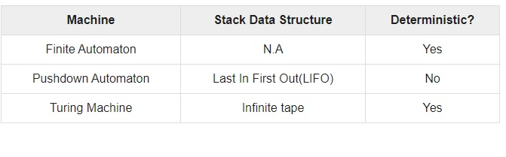
Comparison with the previous automaton

Slide 8
Example of Turing machine
Turing machine M = (Q, X, ∑, δ, q₀, B, F) with
Q = {q₀, q₁, q₂, q_{f}}
X = {a, b}
∑ = {1}
q₀ = {q₀}
B = blank symbol
F = {q_{f} }

Slide 9
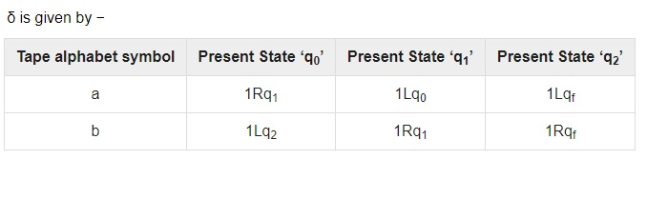
Here the transition 1Rq₁ implies that the write symbol is 1, the tape moves right, and the next state is q₁.
Similarly, the transition 1Lq₂ implies that the write symbol is 1, the tape moves left, and the next state is q₂.

Slide 10

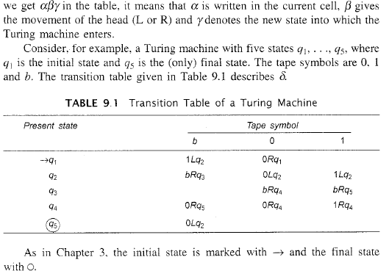

Slide 11
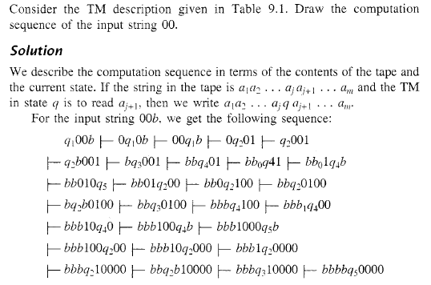

Slide 12
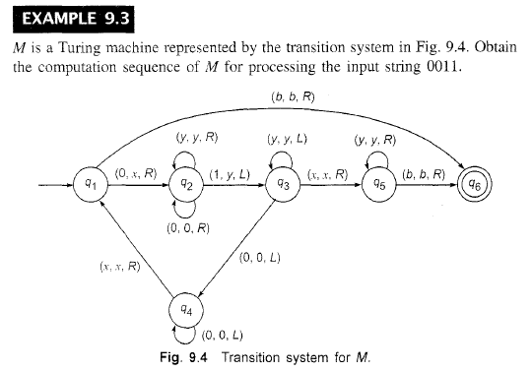

Slide 13
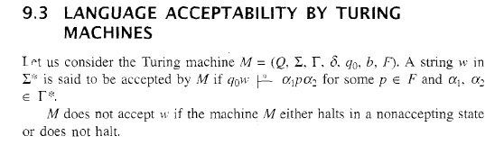
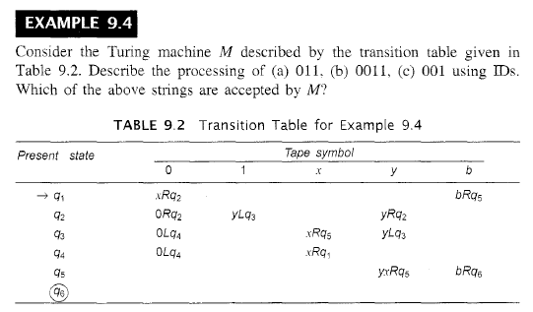

Slide 14
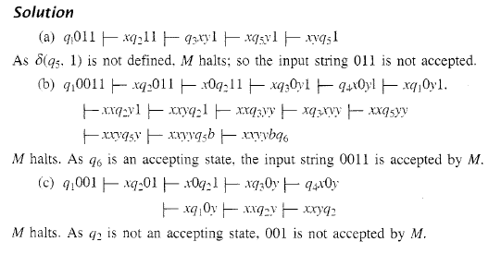

Slide 15
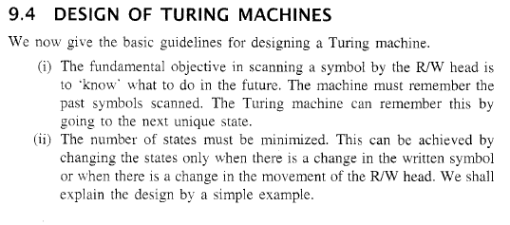


Slide 16
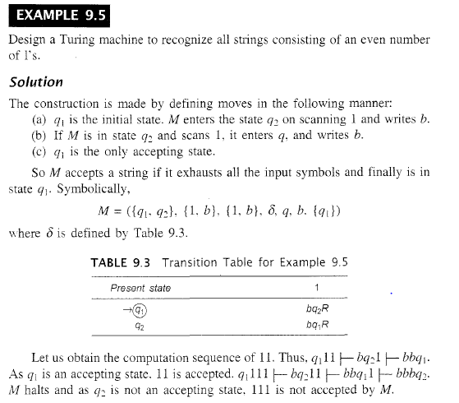

Slide 17
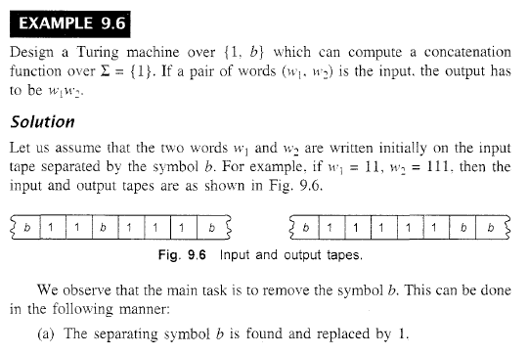

Slide 18
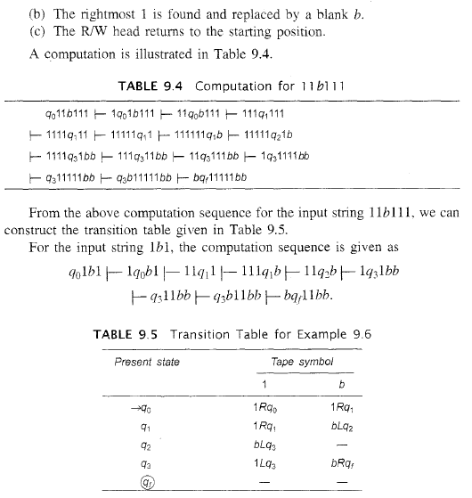

Slide 19
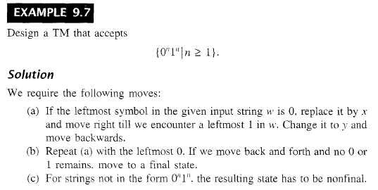

Slide 20
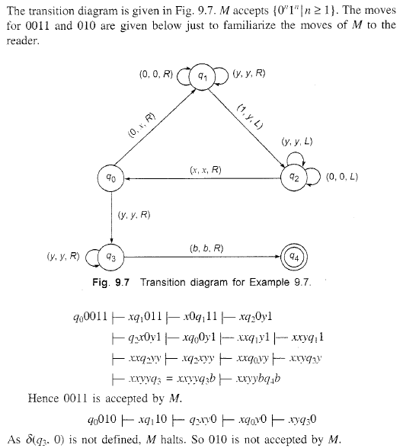

Slide 21

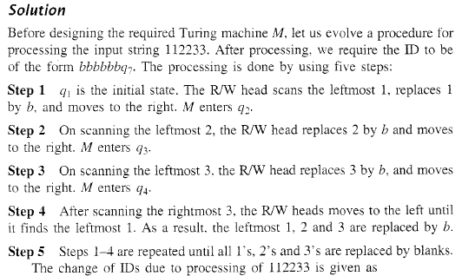
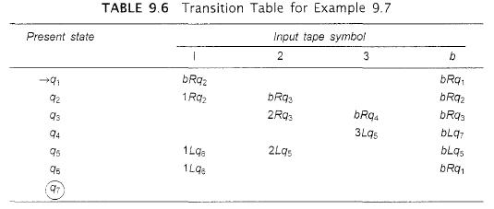

Slide 22
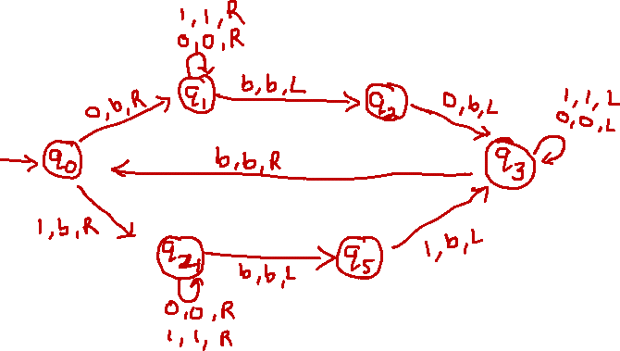
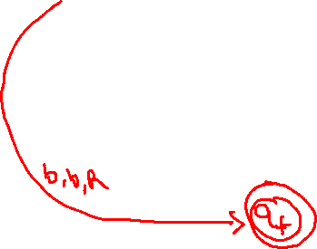
L = ww^{r}, w∈(0,1)*

Slide 23
Types of Turing Machine(Variation)
MultiTape
MultiHead
2way infinite TM
Non Deterministic
Deterministic
Multi Dimensional
Universal

Slide 24
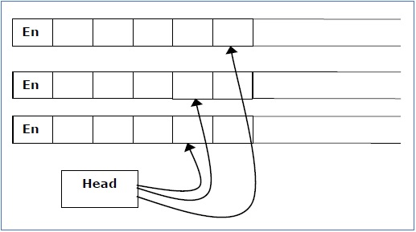
Multi-tape Turing Machine
Multi-tape Turing Machines have multiple tapes where each tape is accessed with a separate head.
Each head can move independently of the other heads. Initially the input is on tape 1 and others are blank.
At first, the first tape is occupied by the input and the other tapes are kept blank.
Next, the machine reads consecutive symbols under its heads and the TM prints a symbol on each tape and moves its heads.

Slide 25
A Multi-tape Turing machine can be formally described as a 6-tuple (Q, X, B, δ, q₀, F) where −
Q is a finite set of states
X is the tape alphabet
B is the blank symbol
δ is a relation on states and symbols where
δ: Q × X^{k} → Q × (X × {Left_shift, Right_shift, No_shift })^{k}
where there is k number of tapes
q₀ is the initial state
F is the set of final states
Note − Every Multi-tape Turing machine has an equivalent single-tape Turing machine.

Slide 26
Multi-track Turing Machine
Multi-track Turing machines, a specific type of Multi-tape Turing machine, contain multiple tracks but just one tape head reads and writes on all tracks.
Here, a single tape head reads n symbols from n tracks at one step.
It accepts recursively enumerable languages like a normal single-track single-tape Turing Machine accepts.

Slide 27
A Multi-track Turing machine can be formally described as a 6-tuple (Q, X, ∑, δ, q₀, F) where −
Q is a finite set of states
X is the tape alphabet
∑ is the input alphabet
δ is a relation on states and symbols where
δ(Q_{i}, [a₁, a₂, a₃,....]) = (Q_{j}, [b₁, b₂, b₃,....], Left_shift or Right_shift)
q₀ is the initial state
F is the set of final states
Note − For every single-track Turing Machine S, there is an equivalent multi-track Turing Machine M such that L(S) = L(M).

Slide 28
Non-Deterministic Turing Machine
In a Non-Deterministic Turing Machine, for every state and symbol, there are a group of actions the TM can have.
So, here the transitions are not deterministic. The computation of a non-deterministic Turing Machine is a tree of configurations that can be reached from the start configuration.

Slide 29
An input is accepted if there is at least one node of the tree which is an accept configuration, otherwise it is not accepted.
If all branches of the computational tree halt on all inputs, the non-deterministic Turing Machine is called a Decider and if for some input, all branches are rejected, the input is also rejected.

Slide 30
A non-deterministic Turing machine can be formally defined as a 7-tuple (Q, X, ∑, δ, q₀, B, F) where −
Q is a finite set of states
X is the tape alphabet
∑ is the input alphabet
δ is a transition function;
δ : Q × X → P(Q × X × {Left_shift, Right_shift}).
q₀ is the initial state
B is the blank symbol
F is the set of final states

Slide 31
Universal TM
In computer science, a universal Turing machine(UTM) is a Turing machine that can simulate an arbitrary Turing machine on arbitrary input.
The universal machine essentially achieves this by reading both the description of the machine to be simulated as well as the input thereof from its own tape.

Slide 32
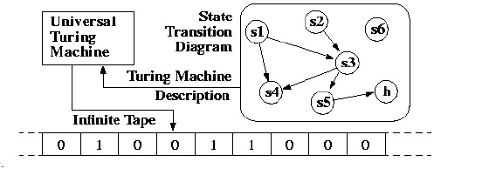
UTM along with the input on the tape, takes in the description of a machine M.
The UTM can go on then to simulate M on the rest of the contents of the input tape.
A universal Turing machine can thus simulate any other machine.

Slide 33
POLLING QUESTIONS
Which of the functions can a turing machine not perform?
a) Copying a string
b) Deleting a symbol
c) Accepting a pal
d) Inserting a symbol
Notes:
d

Slide 34
2. A Language L may not be accepted by a Turing Machine if:
a) It it is recursively ennumerable
b) It is recursive
c) L can be ennumerated by some turing machine
d) None of the mentioned
Notes:
b

Slide 35
3. Turing machine (TM) is more powerful than FMS (Finite State Machine) because
A. Tape movement is confined to one direction
B. It has no finite state
C. It has the capability to remember arbitrarily long sequences of input symbols
D.none of these
Notes:
c

Slide 36
Which of the following automata takes queue as an auxiliary storage?
Finite automata
Push down automata
Turing machine
All of the mentioned
Notes:
c

Slide 37
A context free grammar can be recognized by
Push down automata
2 way linearly bounded automata
both a and b
None of the mentioned
Notes:
c

Slide 38
A linear bounded automaton(LBA) is represented as an 8-tuple (Q, X, ∑, q₀, ML, MR, δ, F). What does X denote?
Initial Symbol
Tape symbol
Blank Symbol
None of these
Notes:
b

Slide 39
Linear Bounded Automata
A linear bounded automaton is a multi-track non-deterministic Turing machine with a tape of some bounded finite length.
Length = function (Length of the initial input string, constant c)
Here,
Memory information ≤ c × Input information

Slide 40
The computation is restricted to the constant bounded area.
The input alphabet contains two special symbols which serve as left end markers and right end markers which mean the transitions neither move to the left of the left end marker nor to the right of the right end marker of the tape.

Slide 41
A linear bounded automaton can be defined as an 8-tuple (Q, X, ∑, q₀, ML, MR, δ, F) where −
Q is a finite set of states
X is the tape alphabet
∑ is the input alphabet
q₀ is the initial state
M_{L} is the left end marker
M_{R} is the right end marker where M_{R} ≠ M_{L}
δ is a transition function which maps each pair (state, tape symbol) to (state, tape symbol, Constant ‘c’) where c can be 0 or +1 or -1
F is the set of final states

Slide 42
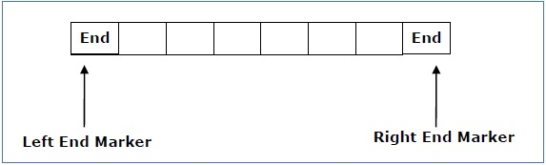
A deterministic linear bounded automaton is always context-sensitive and the linear bounded automaton with empty language is undecidable..

Slide 43
Turing Machine Halting Problem
Input − A Turing machine and an input string w.
Problem − Does the Turing machine finish computing of the string w in a finite number of steps? The answer must be either yes or no.
Proof − At first, we will assume that such a Turing machine exists to solve this problem and then we will show it is contradicting itself. We will call this Turing machine as a Halting machine that produces a ‘yes’ or ‘no’ in a finite amount of time. If the halting machine finishes in a finite amount of time, the output comes as ‘yes’, otherwise as ‘no’.

Slide 44
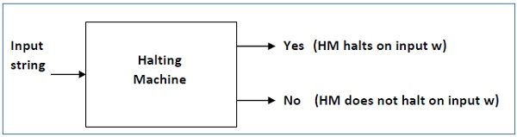
The following is the block diagram of a Halting machine −

Slide 45
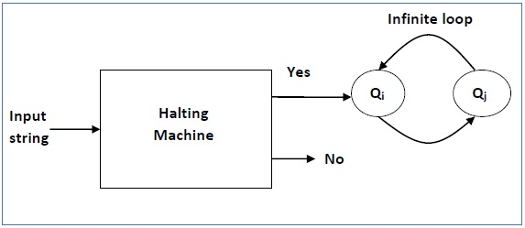
Now we will design an inverted halting machine (HM)’ as −
If H returns YES, then loop forever.
If H returns NO, then halt.
The following is the block diagram of an ‘Inverted halting machine’ −
Further, a machine (HM)₂ which input itself is constructed as follows −
If (HM)₂ halts on input, loop forever.
Else, halt.
Here, we have got a contradiction. Hence, the halting problem is undecidable.

Slide 46
Halting Problem
In computability theory, the halting problem is the problem of determining, from a description of an arbitrary computer program and an input, whether the program will finish running, or continue to run forever.

Slide 47
The problem is to determine, given a program and an input to the program, whether the program will eventually halt when run with that input.
There are no resource limitations on the amount of memory or time required for the program's execution;
It can take arbitrarily long and use an arbitrary amount of storage space before halting.
The question is simply whether the given program will ever halt on a particular input.

Slide 48
For example, in pseudocode, the program
while (true) continue
does not halt; rather, it goes on forever in an infinite loop. On the other hand, the program
print "Hello, world!“
does halt.
While deciding whether these programs halt is simple, more complex programs prove problematic.

Slide 49
Alan Turing proved in 1936 that a general algorithm to solve the halting problem for all possible program-input pairs cannot exist.

Slide 50
POLLING QUESTIONS
1. A turing machine that is able to simulate other turing machines:
a) Nested Turing machines
b) Universal Turing machine
c) Counter machine
d) None of the mentioned
Notes:
b

Slide 51
2. If d is not defined on the current state and the current tape symbol, then the machine ______
a) does not halts
b) halts
c) goes into loop forever
d) none of the mentioned
Notes:
b

Slide 52
3. Which of the following are the models equivalent to Turing machine?
a) Multi tape turing machine
b) Multi track turing machine
c) Register machine
d) All of the mentioned
Notes:
d

Slide 53
4. Which of the following is true for The Halting problem?
a. It is recursively ennumerable
b. It is undecidable
c. both a and b
d. None of the mentioned
Notes:
c

Slide 54
The machine accept the string by entering into hA or it can:
a) explicitly reject x by entering into hR
b) enter into an infinte loop
c) explicitly reject x by entering into hR and enter into an infinte loop
d) None of the mentioned

Slide 55
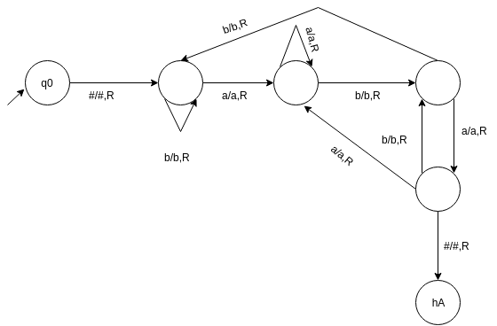
a) {a}*{b}*{a,b}
b) {a,b}*{aba}
c) {a,b}*{bab}
d) {a,b}*{a}*{b}*
Notes:
c

Slide 56
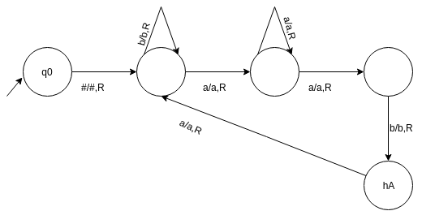
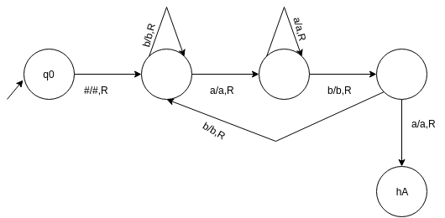
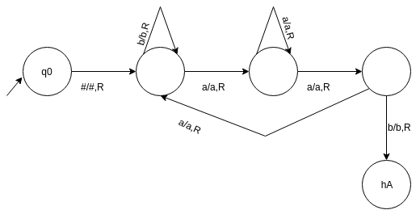
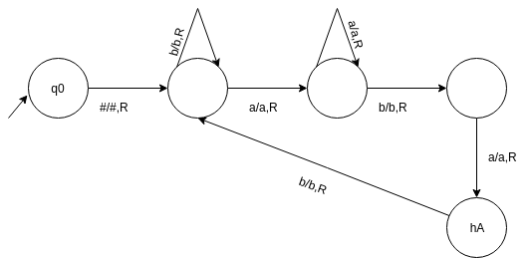
Construct a turing machine which accepts a string with ‘aba’ as its substring
a)
b)
c)
d)
Notes:
c

Slide 57
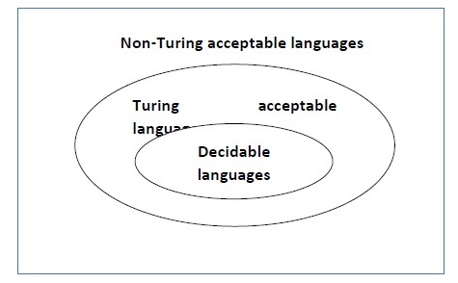
Language Decidability
A language is called Decidable or Recursive if there is a Turing machine which accepts and halts on every input string w. Every decidable language is Turing-Acceptable.

Slide 58
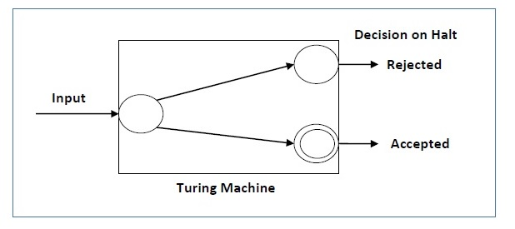
A decision problem P is decidable if the language L of all yes instances to P is decidable.
For a decidable language, for each input string, the TM halts either at the accept or the reject state as depicted in the following diagram −

Slide 59
Example 1
Problem: Find out whether the following problem is decidable or not − Is a number ‘m’ prime?
Solution: Prime numbers = {2, 3, 5, 7, 11, 13, …………..}
Divide the number ‘m’ by all the numbers between ‘2’ and ‘√m’ starting from ‘2’.
If any of these numbers produce a remainder zero, then it goes to the “Rejected state”, otherwise it goes to the “Accepted state”. So, here the answer could be made by ‘Yes’ or ‘No’.
Hence, it is a decidable problem.

Slide 60
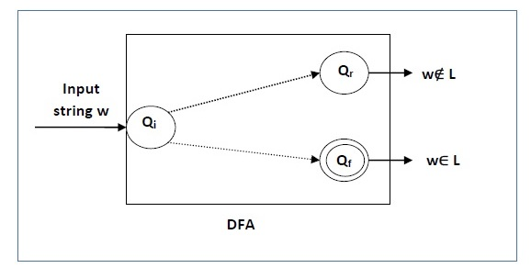
Example 2
Problem: Given a regular language L and string w, how can we check if w ∈ L?
Solution: Take the DFA that accepts L and check if w is accepted

Slide 61
Some more decidable problems are −
Does DFA accept the empty language?
Is L₁ ∩ L₂ = ∅ for regular sets?
Note −
If a language L is decidable, then its complement L' is also decidable
If a language is decidable, then there is an enumerator for it.

Slide 62
Undecidable Languages
For an undecidable language, there is no Turing Machine which accepts the language and makes a decision for every input string w (TM can make decision for some input string though).
A decision problem P is called “undecidable” if the language L of all yes instances to P is not decidable.
Undecidable languages are not recursive languages, but sometimes, they may be recursively enumerable languages.

Slide 63
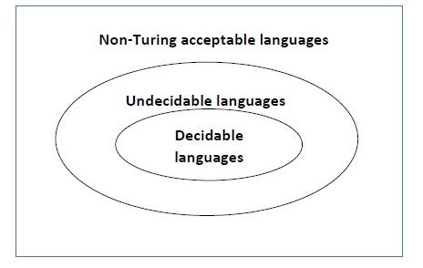

Slide 64
Decision Problems(CO5)
Recursive Language: A language L is recursive language if there is a Turing machine that accepts the language and halts on all inputs.
w
M
w ϵ L(M)
Yes No
Recursively Enumerable Language: if there is a Turing machine that accepts the language by halting when the input string is in the language.
  The machine may or may not halt if the string is not in the language.
w
M
w ϵ L(M)
Yes

Slide 65
Example
The halting problem of Turing machine
The mortality problem
The mortal matrix problem
The Post correspondence problem, etc.

Slide 66
Conclusion
A problem is said to be Decidable if we can always construct a corresponding algorithm that can answer the problem correctly.
A problem is said to be a Decidable problem if there exists a corresponding Turing machine which halts on every input with an answer- yes or no.

Slide 67
The problems for which we can’t construct an algorithm that can answer the problem correctly in finite time are termed as Undecidable Problems.

Slide 68
POLLING QUESTIONS
1. A language L is said to be ____________ if there is a turing machine M such that L(M)=L and M halts at every point.
a) Turing acceptable
b) decidable
c) undecidable
d) none of the mentioned
Notes:
b

Slide 69
2. The problems which have no algorithm, regardless of whether or not they are accepted by a turing machine that fails to halts on some input are referred as:
a) Decidable
b) Undecidable
c) Computable
d) None of the mentioned
Notes:
b

Slide 70
3.Recursive languages are also known as:
a) decidable
b) undecidable
c) sometimes decidable
d) none of the mentioned
Notes:
a

Slide 71
4. Which of the following was not a part of Chomsky hierarchy ?
a) Context sensitive grammar
b) Unrestricted grammar
c) Recursive grammar
d) None of the mentioned
Notes:
c

Slide 72
5. Decidable can be taken as a synonym to:
a) recursive
b) non recursive
c) recognizable
d) none of the mentioned
Notes:
a

